Slide 1

LOOP ENGINEERING
Modern AI systems don't just respond — they reason, act, observe, and repeat. Loop engineering is the discipline of building those iterative cycles into production-grade agents.
REASON → ACT → OBSERVE → REPEAT

Slide 2
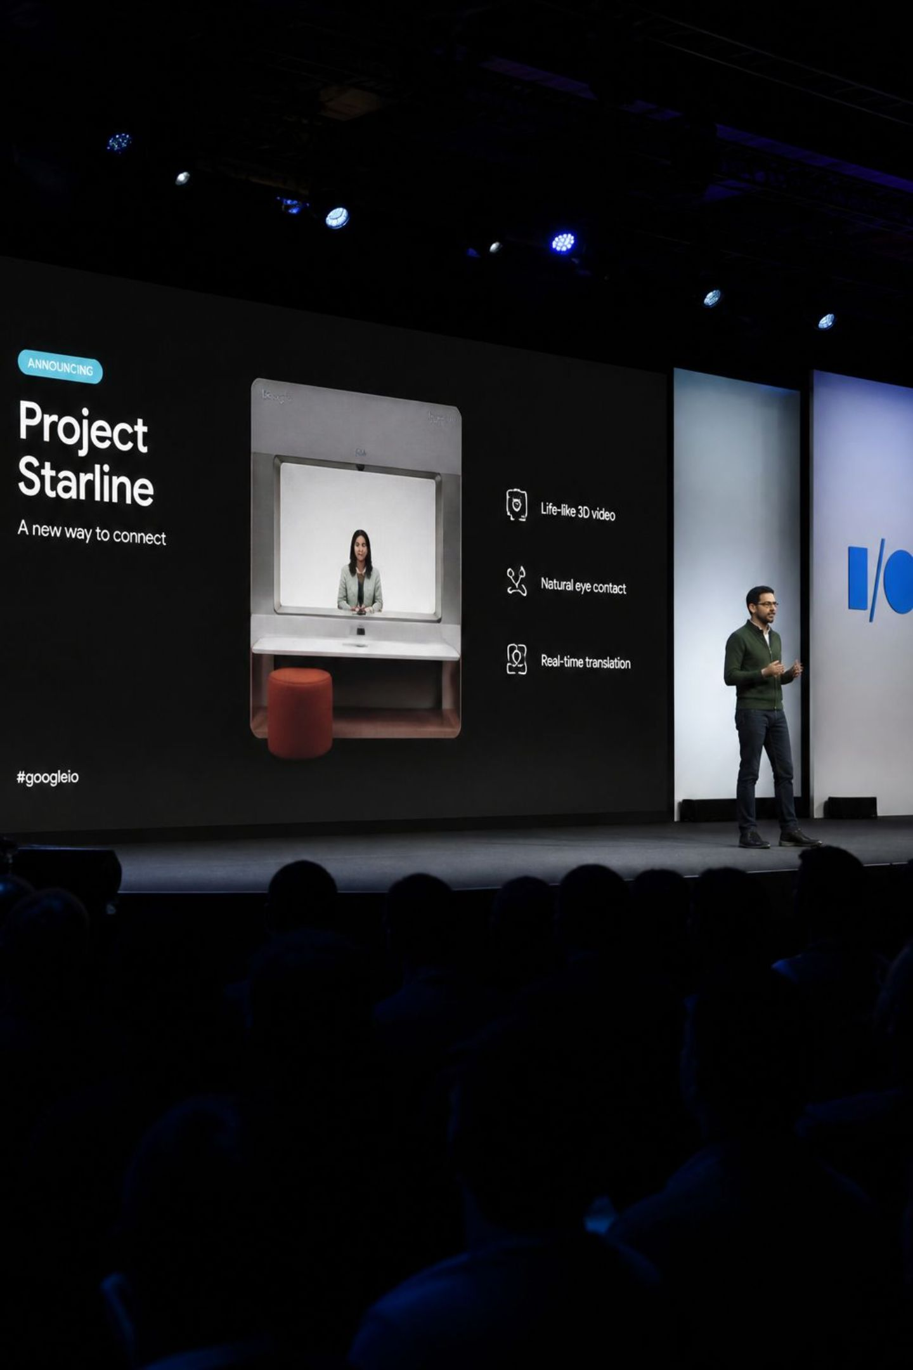
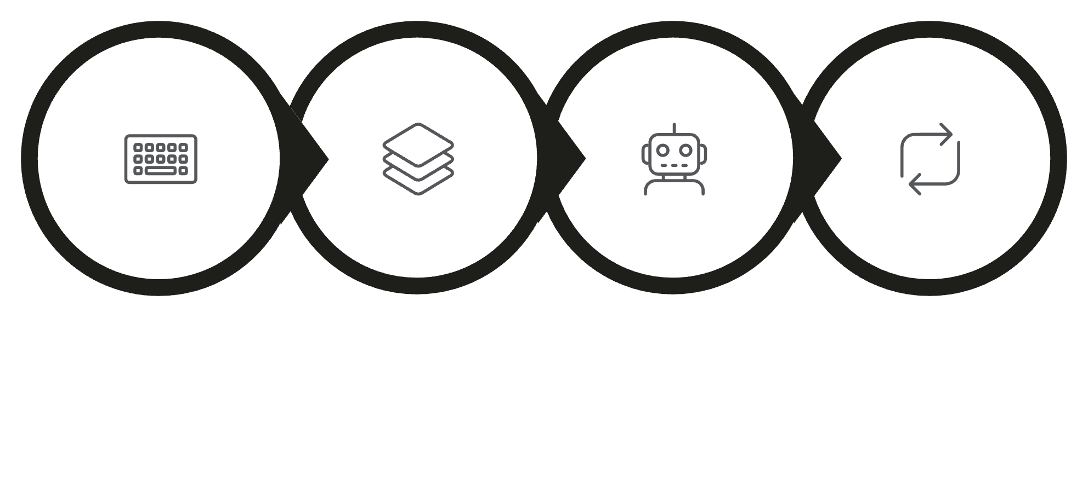
WHY IS EVERYONE TALKING ABOUT IT?
Industry leaders are signaling a fundamental shift: AI products are no longer just chatbots — they're becoming agents.
PETER STEINBERGER
OpenAI — on the rise of agentic systems
BORIS CHERNY
Anthropic — on agent architecture
PROMPT ENG.
CONTEXT ENG.
AGENT ENG.
LOOP ENG.
The industry has evolved from simple prompts to full iterative loop systems.

Slide 3












HOW DOES A LOOP WORK?
Every loop follows a conceptual lifecycle — from initial discovery through reflection and repetition.
DISCOVER
PLAN
Identify the problem or goal
Break down the approach
REPEAT
EXECUTE
Iterate until done
Take action via tools
REFLECT
OBSERVE
Evaluate results
Read the output
This explains what happens during execution — but production systems require much more than a simple loop.

Slide 4






FROM CONCEPTUAL LOOPS TO PRODUCTION LOOPS
Addy Osmani's six primitives define what it takes to engineer a real production loop.
AUTOMATIONS
Trigger recurring work
WORKTREES
Isolated workspaces per agent — no overwrites, shared repo history, true parallel execution
SKILLS
Reusable knowledge
PLUGINS / MCP
Tool integration
SUB-AGENTS
Specialized responsibilities
PERSISTENT MEMORY
Long-term state

Slide 5

WHAT MAKES A GOOD LOOP?
DESIGN QUESTIONS ENGINEERS ASK
METRICS TO OPTIMIZE
Should I retry?
Should I stop?
Should I ask another agent?
Should I verify?
Should I use another tool?
What should I remember?
Success Rate
Cost
Latency
Number of Iterations
Tool Success Rate
Recovery Rate
Many production agents complete tasks in approximately 3–10 iterations. Frameworks expose configurable iteration limits to balance accuracy, latency, and cost.

Slide 6
FRAMEWORK SUPPORT
Frameworks help implement production loops — each with different strengths across key capabilities.
Feature
LangGraph
OpenAI Agents SDK
AutoGen
Durable Exec.
Checkpoints
✅
Trace-based
Partial
✅
Tool Calling
✅
✅
✅
✅
Human Approval
✅
Partial
Partial
✅
State
✅
Session
Agent memory
✅
"The art of loop engineering is designing how an agent iteratively plans, executes, evaluates, and adapts — not simply prompting it." — LangChain

Slide 7




REAL-WORLD APPLICATIONS
LOOPS IN ACTION
SOFTWARE DEVELOPMENT
CUSTOMER SUPPORT
RESEARCH ASSISTANT
CYBERSECURITY
Problem: One alert isn't enough.
Loop: Collect logs → Correlate → Investigate → Escalate
Outcome: Faster incident response.
Problem: One prompt cannot reliably fix a bug.
Loop: Analyze → Modify → Test → Observe → Retry
Outcome: Autonomous debugging.
Problem: Refunds require verification.
Loop: Read account → Check purchase → Verify policy → Execute refund
Outcome: Policy-compliant automation.
Problem: One search rarely finds sufficient evidence.
Loop: Search → Read → Compare → Search again
Outcome: Evidence-backed synthesis.

Slide 8

CHALLENGES & BEST PRACTICES
KEY CHALLENGES
BEST PRACTICES
Infinite loops: Always set iteration limits
Cost explosion: Monitor token usage per iteration
Observability: Log every step for debugging
Non-determinism: Temperature and model variance affect reproducibility
Define clear termination conditions
Use structured outputs for parsing
Implement human-in-the-loop checkpoints
Cache repeated tool calls
Version your prompts
Without iteration limits, agents can enter infinite loops — always enforce a maximum step count in production systems.

Slide 9


WHAT'S NEXT: THE FUTURE OF LOOP ENGINEERING
Loop engineering is evolving rapidly. Three major trends are shaping the next generation of agentic systems.
MULTI-AGENT COLLABORATION
Agents delegating subtasks to specialized peers for complex workflows
MEMORY & PERSISTENCE
Long-term state enabling agents to learn across sessions and tasks
HUMAN-IN-THE-LOOP
Strategic checkpoints where humans guide, approve, or override agent decisions

Slide 10

CONCLUSION & KEY TAKEAWAYS
1
LOOPS ARE THE CORE OF AGENTIC SYSTEMS
Iterative reasoning separates agents from simple chatbots
2
ENGINEERING MATTERS
Worktrees, memory, and sub-agents transform concepts into production systems
3
DESIGN DETERMINES QUALITY
Success rate, cost, latency, and recovery depend on loop architecture
4
THE FUTURE IS ITERATIVE
Multi-agent collaboration, persistence, and human oversight define what's next

